Slide 1
Capstone Project - The Battle of Neighborhoods
Sebastián Cardona

Slide 2
Which is the best location for a construction project in a intermediate size city in Colombia
Today construction companies need to choose carefully the places where they plan to build, because today people have a lot of options to choose, so it is important that a construction company attracts their clients by giving them a strategic location, so what if we can create a model to choose the better location for a living building, I will do it for a medium size city like Medellin, Colombia. It is needed that you know that Medellin is divided in 16Th districts, so I will recompile dates from Foursquare API to determine which is the best district to construct base in types and amenities closed to each one.

Slide 3
Data section
District location will be obtained by manual google search, and to explore across different venues according to the presence of amenities and essential facilities, we will access data through FourSquare API interface and arrange them as a dataframe for visualization

Slide 4
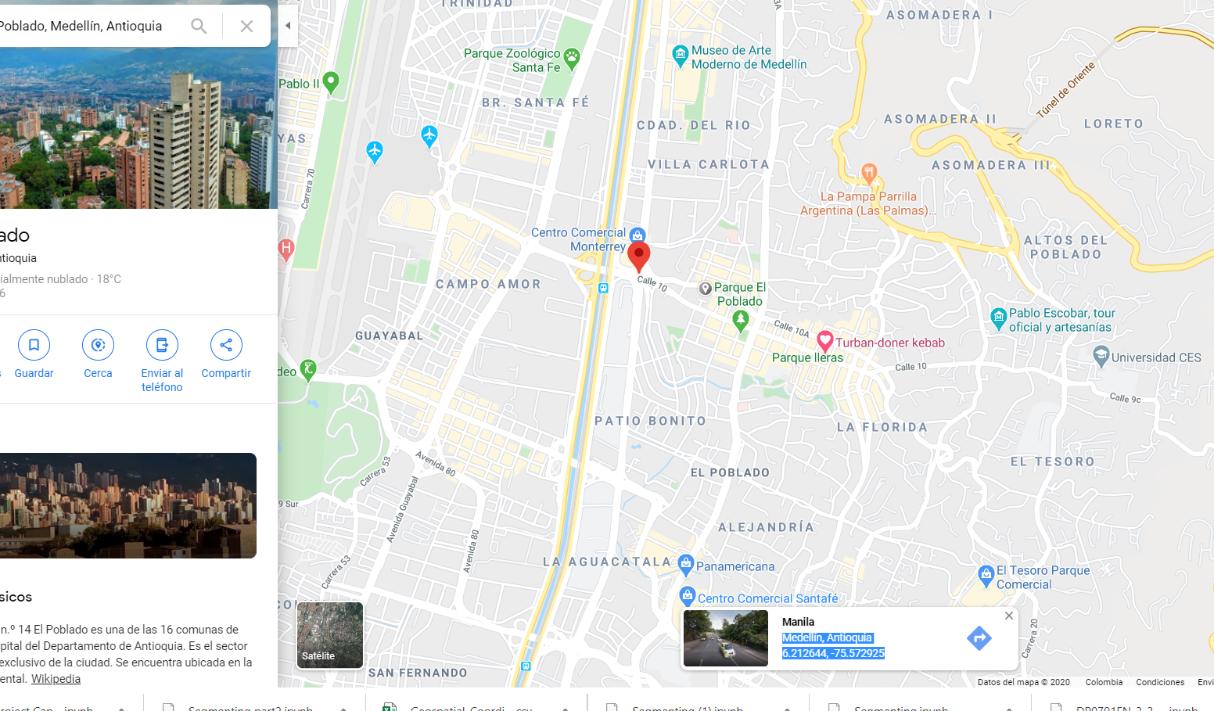
Getting data manually

Slide 5
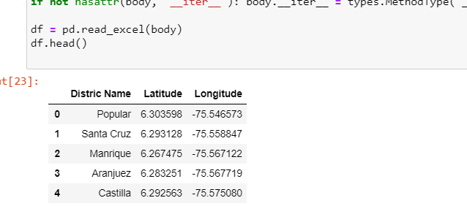
Importing it to phyton as a Excel doc

Slide 6
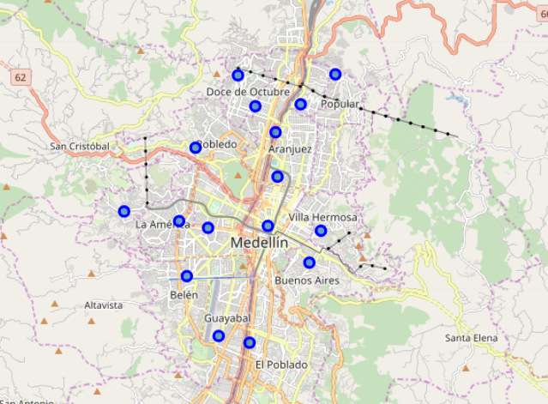
Districs distribution

Slide 7
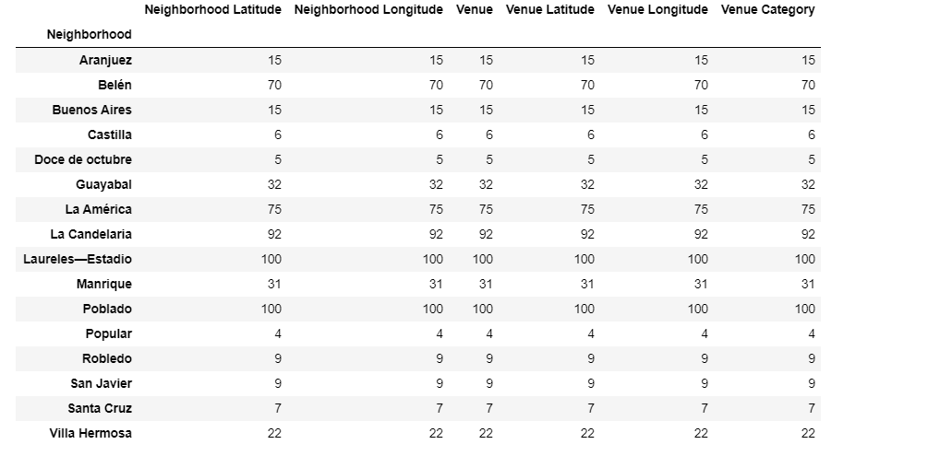
Count of values per district

Slide 8
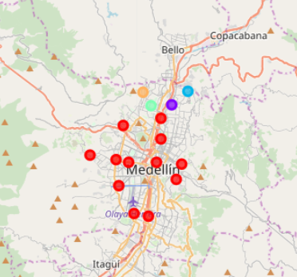
Cloustering

Slide 9
Results and discussion
After all the analysis we obtain that we have 2 Districts that are huge better than the others, these are: Poblado and Laureles, they have a huge concentrations of revenue places, so it will be ideal places to construction companies to build.
other important conclusion is that as a construction company we have to be far away from districts located in cluster 1 to 5, these locations are totally far to the revenue places of the city.
I can conclude that do this analysis in a medium size city implies low data, and some of it should be obtained manually.
It will be great to compare other medium size cities in order to look better places of construction

